Slide 1



X
Manual Testing, API Testing, QA Automation Testing
QA Engineer - Jubelio
Presented by
Jamalul Ikhsan
Virtual Internship Experience – Rakamin (Batch April 2023)

Slide 2

Disclaimer
Kalian dapat mengganti design template ini sesuai kreativitas kalian.
Template ini hanya bertujuan untuk memberikan gambaran isi konten yang wajib dibuat oleh peserta.

Slide 3

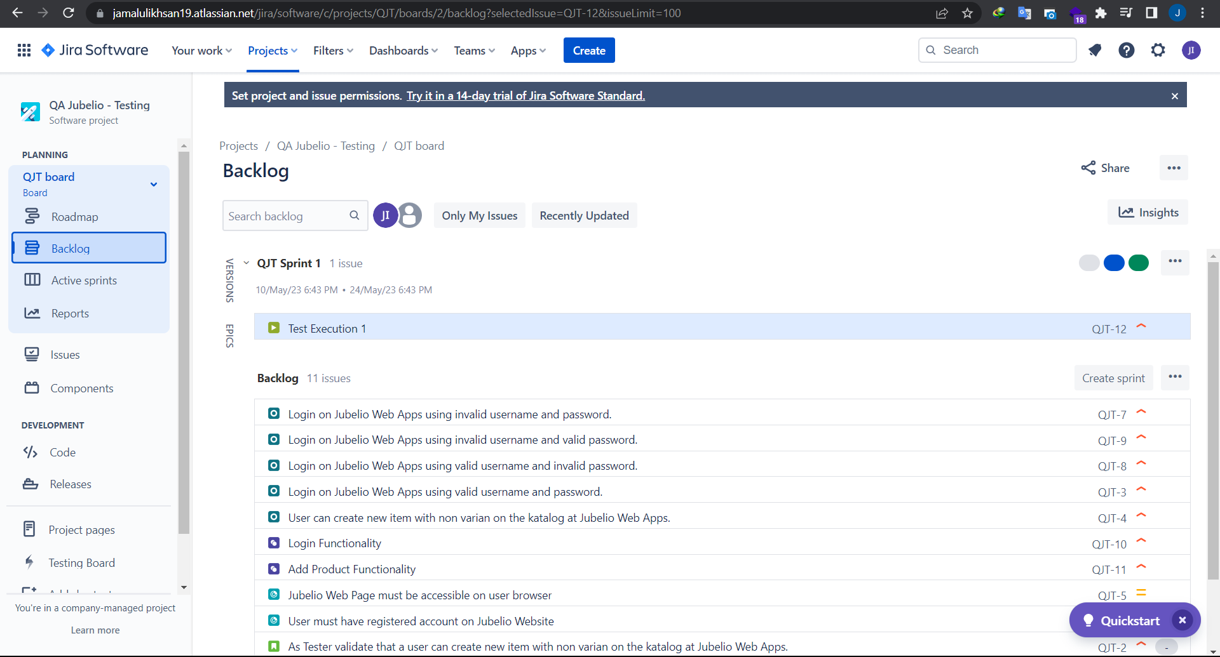
Case Study
Manual Testing Website Jubelio.
Tools : Xray at Jira

Slide 4
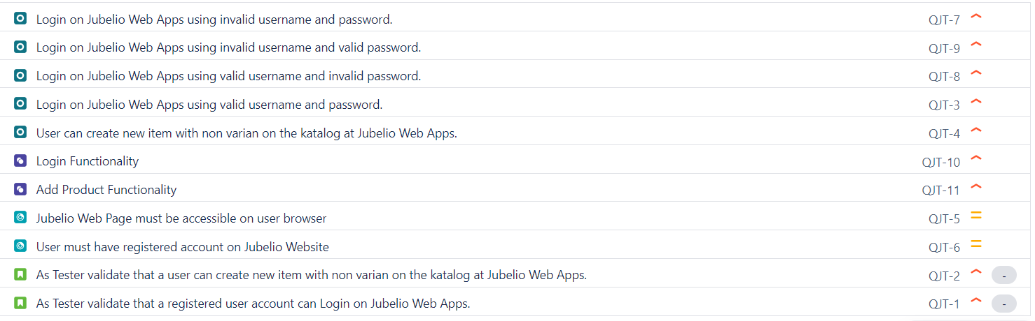
Manual Testing-Xray
1) User Story
2) Preconditions
3) Test Case
4) Test Set

Slide 5
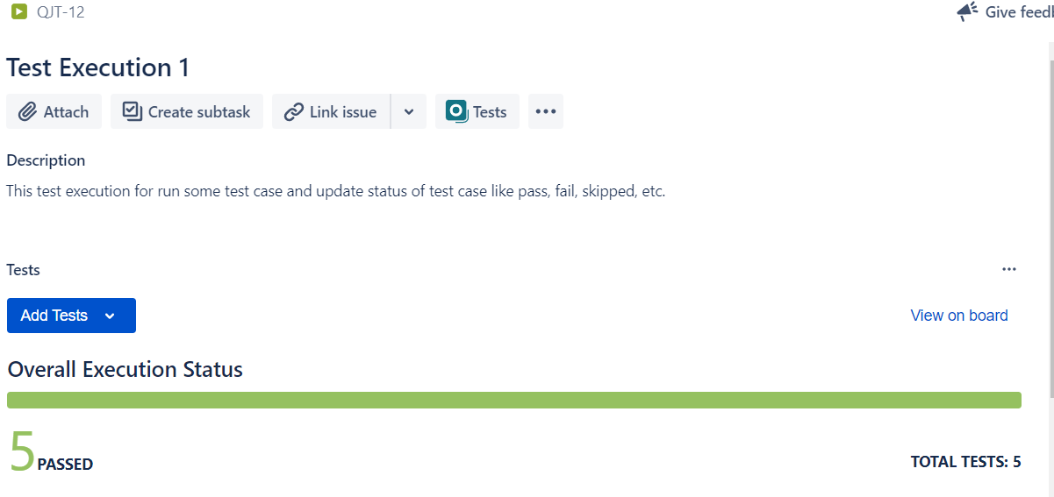
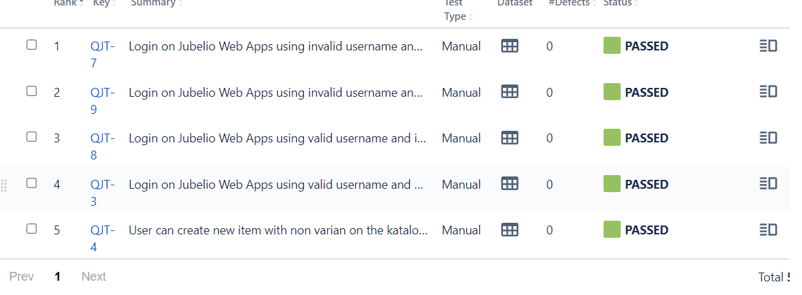
Manual Testing-Xray
5) Test Execution

Slide 6
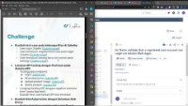
Recording Video – Manual Test
Check this link : https://youtu.be/yl6Dj-DrhcE

Slide 7
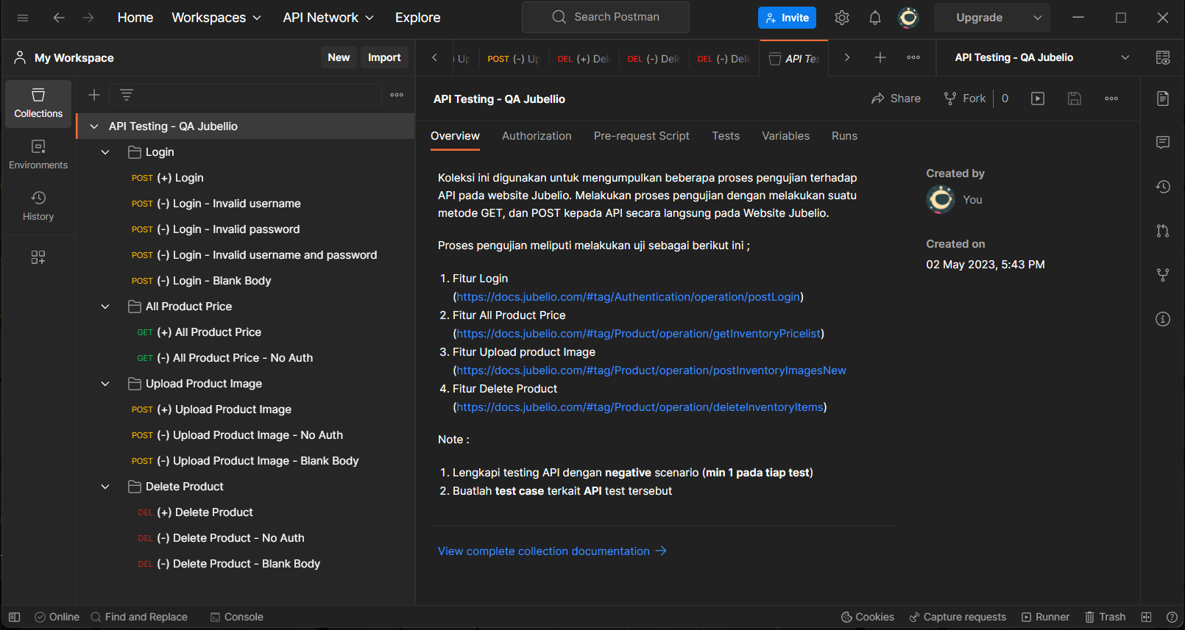
Case Study
API Testing Jubelio.
Tools : Postman

Slide 8
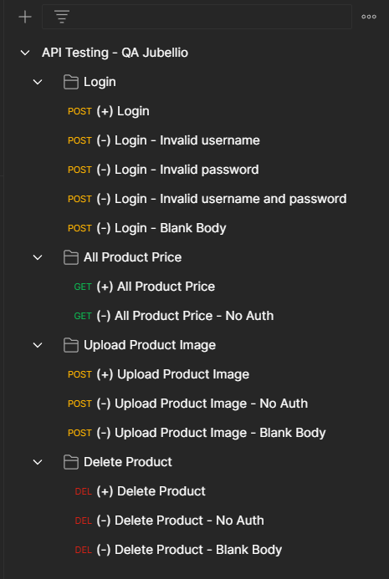
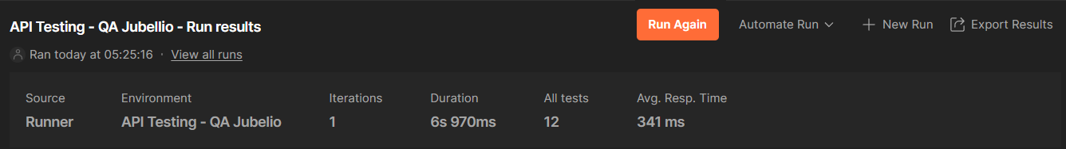
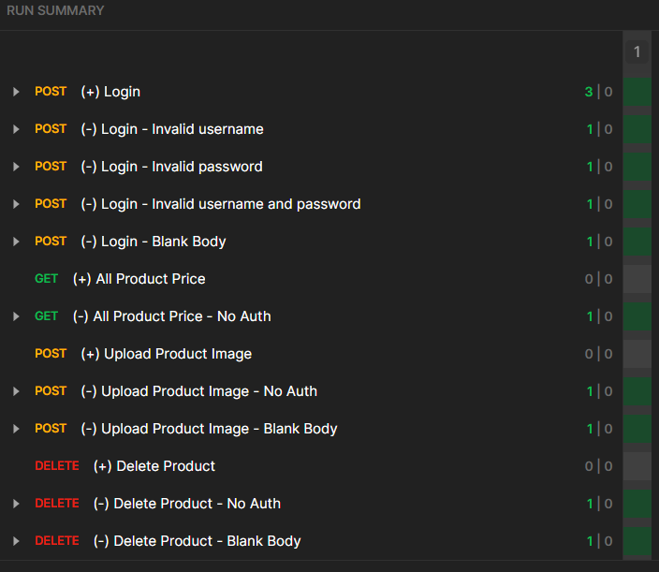
API Testing-Postman
1) Test Case API Testing
2) Summary Result of API Testing

Slide 9
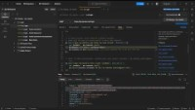
Recording Video – Manual Test
Check this link : https://youtu.be/3U_LC05LbdE

Slide 10
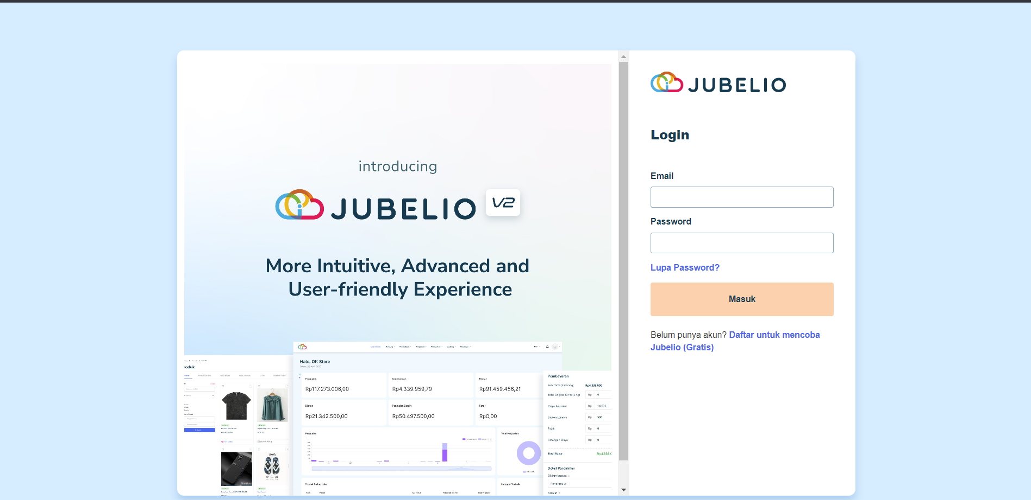
Case Study
QA Automation Testing Jubelio.
Tools : Selenium Webdriver Java

Slide 11
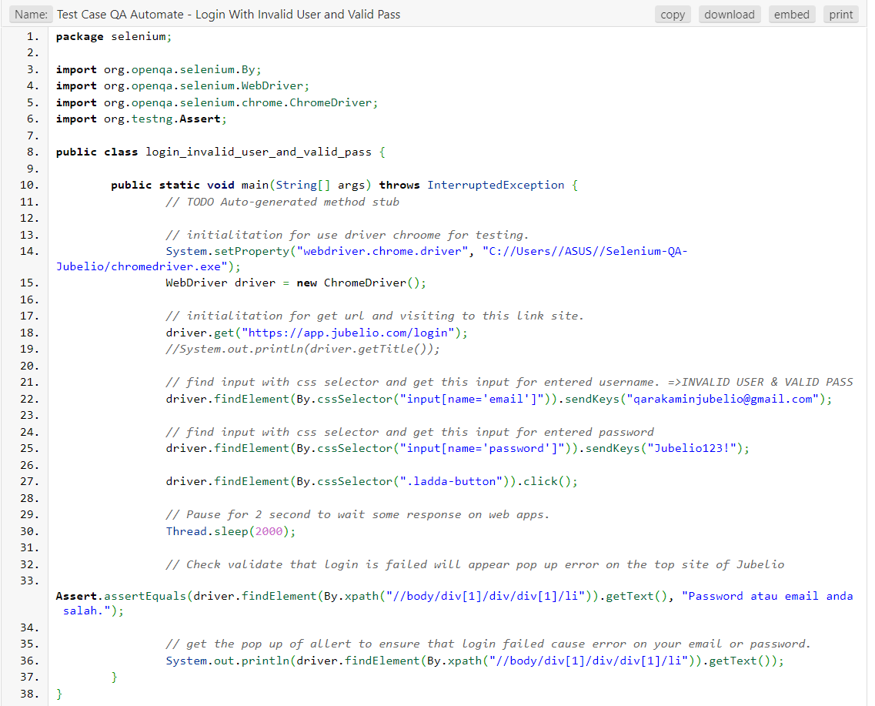
QA Automate Testing-Selenium
1) Test case QA Automate – Login with Invalid User and Valid Pass
Check code on this link :
https://wtools.io/paste-code/bM6R

Slide 12
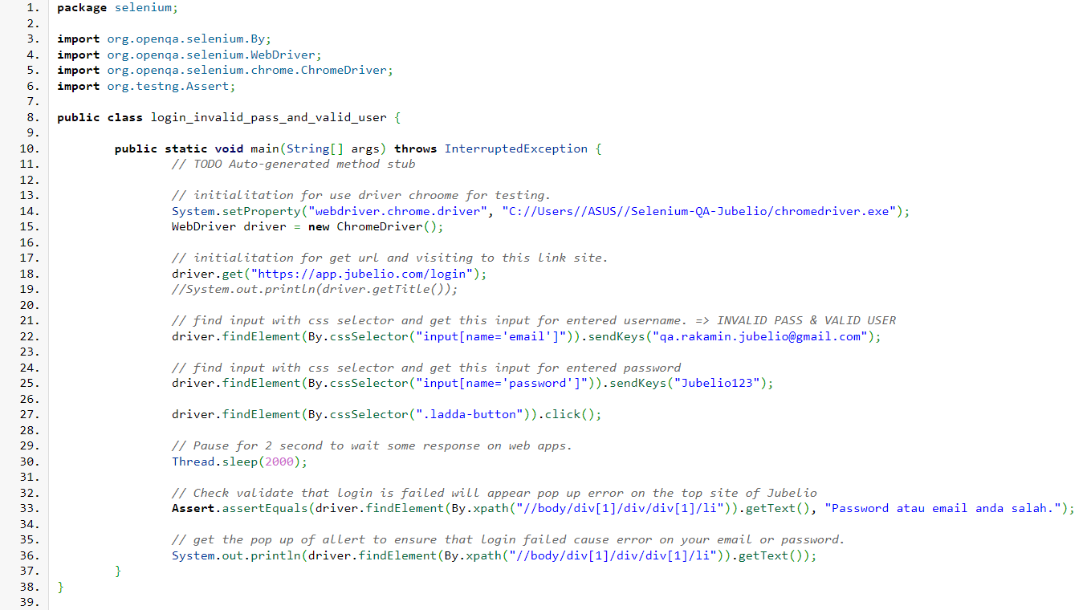
QA Automate Testing-Selenium
2) Test case QA Automate – Login with Invalid Pass and Valid User
Check code on this link :
https://wtools.io/paste-code/bM6S

Slide 13
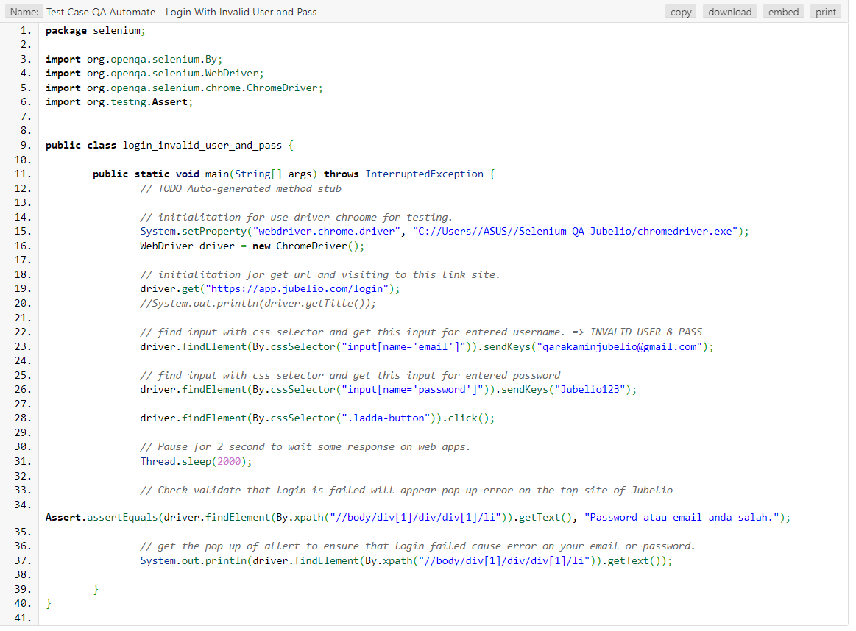
QA Automate Testing-Selenium
3) Test case QA Automate – Login with Invalid User and Pass
Check code on this link :
https://wtools.io/paste-code/bM6V

Slide 14
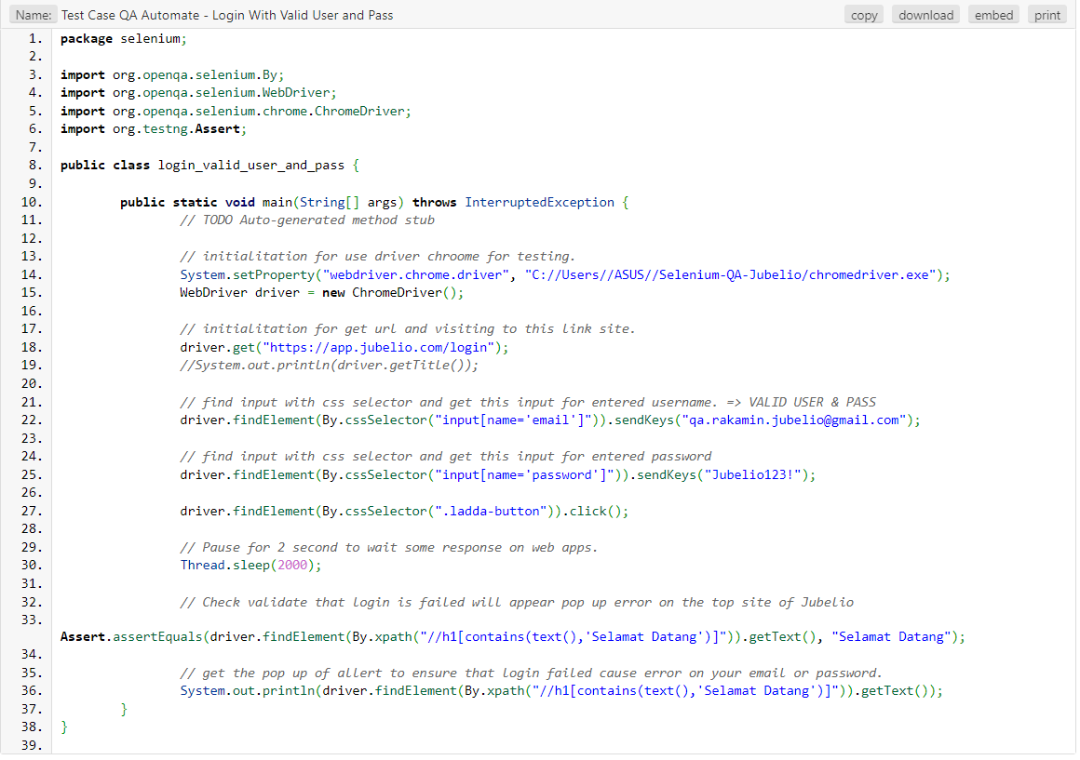
QA Automate Testing-Selenium
4) Test case QA Automate – Login with Valid User and Pass
Check code on this link :
https://wtools.io/paste-code/bM6W

Slide 15
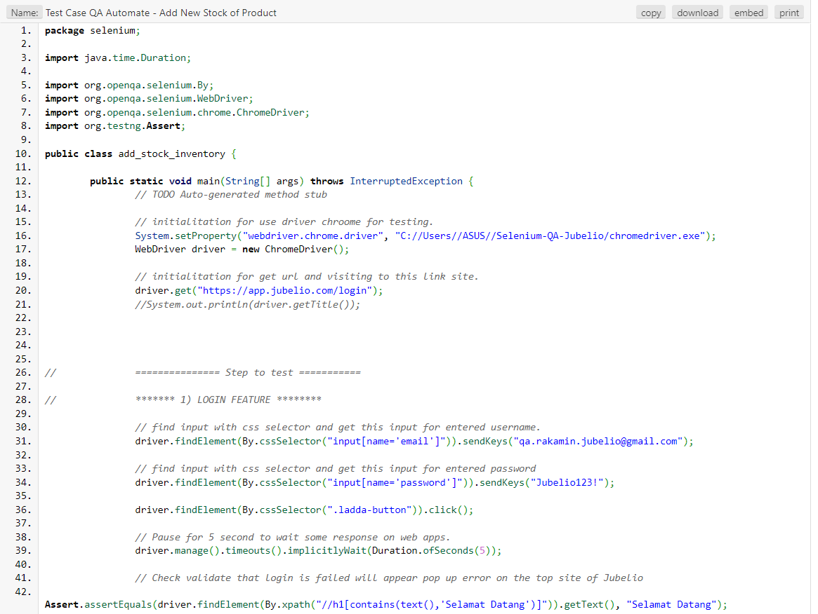
QA Automate Testing-Selenium
5) Test case QA Automate – Add New Stock of Product
Check code on this link :
https://wtools.io/paste-code/bM6X

Slide 16
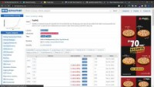
Recording Video – Manual Test
Check this link : https://youtu.be/Pz4D6zEqD4A

Slide 17
Github Repository
QA Jubelio Repository
Check repository on this link :
https://github.com/jamalull/qa-jubelio

Slide 18
Thank You
X

